Slide 1
BUSINESS & INDUSTRIAL ECONOMICS:
Course presentation
Luca Grilli
Department of Management, Economics and Industrial Engineering
Politecnico di Milano
luca.grilli@polimi.it

Slide 2
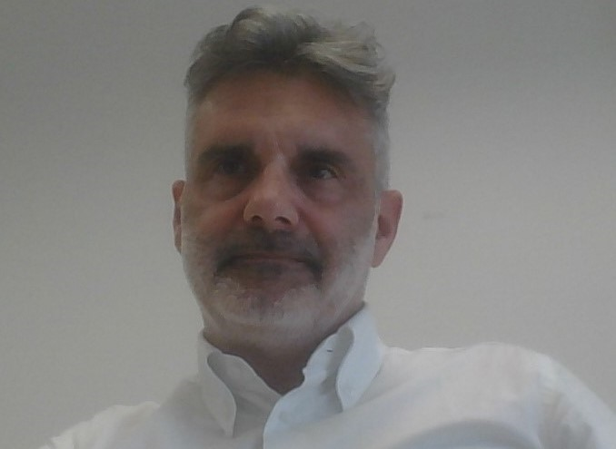
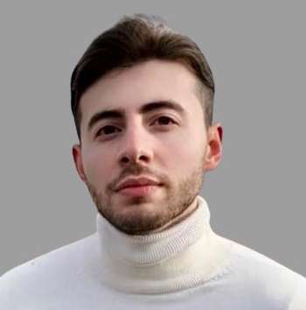
Lecturers*: Contact information
Full Professor in BIE: Luca Grilli
E-mail: luca.grilli@polimi.it
[Office: Bovisa Campus, Department of Management, Economics, and Industrial Engineering, via Lambruschini 4/b, 20156, Milano (3rd floor, office 3.01)]
Assistant Professor: Mattia Pedota
E-mail: mattia.pedota@polimi.it
*Please check that you are in the right BIE grouping

Slide 3
Course material
Course materials will be made available on the course Web page on WeBeep
Any relevant info will be on WeBeep
Any news will be communicated through WeBeep (2023-2024 version)
To successfully pass the exam you only need slides & notes (& recorded lectures or videos).
At the end of each lecture we will indicate bibliography and references for further reading, but please note that exams will only deal with something taught during classes and/or made available through WeBeep.

Slide 4
Scheduling
The (provisional) calendar of the course is already available (subject to potential changes). Lectures will be held on Tuesday (2hr), Thursday (3hr), Friday (3hr).
In the calendar we also indicate the modality (in-presence or virtual). Flipped classes will be held virtually.
Changes to the calendar and modality of lectures (in-presence or virtual) are always possible but we will do our best to communicate them well-in-advance.
Generally, classes will be recorded and made available on WeBeep.
But in accordance with School’s advice and recommendations, in-presence lectures will be taught exclusively for students who follow the lecture in-presence, e.g. students who follow from remote (i.e. streaming will be available) can not intervene during lecture.
Occasionally, a lecture can be substituted by a pre-recorded video.

Slide 5
Scheduling
Business and Industrial Economics [G-O]
Class: Days
 | L07 | Tuesday | 08.15-10.15 (generally starts at 8.30)
 | B8 1.1 | Thursday | 10.15-13.15 (generally starts at 10.30)
 | B8 0.9 | Friday | 14.15-17.15 (generally starts at 14.30)
Webex platform, Microsoft Teams if problems with Webex (for virtual classes).

Slide 6
Program
Efficiency, coordination, and economic organization
Competitive structures & Oligopolistic markets
Market failures
Alternative theories of the firm and their implications
Technological change and innovation
Industrial and competition policy

Slide 7

Actors
Trade and maximum social welfare
General Economic Equilibrium in perfect competition (static efficiency)
Industrial and Competition policy
dynamic efficiency
Innovation
Source of market failure
(e.g. Market power)
Market failures:
Market power
Externalities
Asymmetric Info
Transaction costs
2 domains
Firm
Remedy to market failure (e.g. transaction costs)
Growth

Slide 8
Understanding the business context
The course has a double perspective and double lens
Goal of the analysis/ Perspective | Understand how things are | Decide what to do
Business-level (managers) | Is there market power? Under which conditions? What does it imply for the firm? For the customer?... | How shall we sustain market power and/or face competition?
Society-level (policymakers) |  | What shall we do about it? How social welfare can increase?

Slide 9
BIE course: Learning outcomes
1) Know concepts and definitions about the components and impacts of business and institutional contexts on firms' conducts and performance
2) Understand models and economic rationales that explain how the business context causes business conducts, firm performance and social welfare
3) Apply the instruments provided in the course to the analysis of real-world cases and industries to enhance managerial and policy-making decision making

Slide 10
BIE course: Learning outcomes and assessment
Outcomes
A. Know BIE concepts and definitions
B. Understanding BIE models and economic rationales
C. Applying the BIE course instruments to the analysis of real-world cases and industries
Assessment
Multiple choice questions [c.a. 1/3]
Structured question [c.a. 1/3]
General question(s) and/or mini case-study to discuss (this latter can optionally leverage on material that will be eventually distributed to enrolled students just 2 days before the exam is taking place)[c.a. 1/3]
Flipped classes (optional): Extra points [Max 2 – occasionally up to 3 for outstanding performance]
Each assessment instrument may apply indiscriminately to all three learning outcomes

Slide 11
Flipped classes: Learning to analyze real-world industries
Team formation
Team: 6 students
Send 1 email per team to Mattia Pedota (mattia.pedota@polimi.it) and Luca Grilli (luca.grilli@polimi.it) in cc. Send only once and only by the “corresponding student”
Send the email: 04 March – 13 March, 2024 (emails before or after disregarded).
Email subject: BIE 2024 team
Email text: List of the team members
Name, Surname, Polimi Personal code (NOT Matricola)
Name, Surname, Polimi Personal code
……..
Team assignment
Each team will be assigned to a MACRO GROUP (A, B, C, D) and will have dates of interactive classes.
Case assignment
C.a. 1 week in advance of the class date, the case study material will be uploaded on WeBeep.

Slide 12
Flipped classes: Learning to analyze real-world industries
Class work
Each student has to carefully read the case study before coming to the virtual class
Flipped classes will be held virtually
Brief introduction by the lecturers and assignment of questions: 5 min.
Teamwork: 50-60 minutes to talk with teammates and formulate answers/views/comments in 2-3 slides.
50-60 minutes for Teams’ presentations and open discussion.
10-15 minutes for the wrap up by the teacher.
Assessment
Max 2 (3) extra points on the top of the exam grade, Average grade over the flipped classes (published with the assessment of the 1st exam call in June)
Criteria
Capability to apply BIE instruments
Interaction in class
Originality
[Note also that diversity of the team (Country, Gender) will be appreciated]
(Likely) Case studies on: Oligopolistic Markets, Firm Growth, Innovation, Antitrust
Remember:
Flipped class mark has a validity of 1 academic year. Flipped classes can be taken only by students who did not take them in previous academic years. [Those few students who have taken FCs last years should send an email to Prof. Luca Grilli, in the above reported time-frame (March 4-13), informing about their status, without taking part to any team formation activity].

Slide 13
Prerequisites and Mandatory courses
If you received the MOOC of “Economics” as a compulsory commitment by the Admission Committee during the Admission process
You are required to complete it by the deadline set by our Teaching offices in order to be allowed to participate to June / July calls.
Operative instructions:
Please, enrol to the MOOC using your POLIMI personal code and save the Certificate of Accomplishment after the completion of the course (you can be required by the programme office to provide it).
Consider that the Certificate of Accomplishment reports the full name that you provided when you registered; before the end of the course check your name as it appears in the Full Name field, before the certificate is created. (Click the arrow by your username on the top right of the page and select Account. You will find the Full Name field in the next page)

Slide 14
Prerequisites and Recommendations
Prerequisites of the course = Microeconomics basics
MOOC course of Economics
Rules: See the last slide
Warm advise of lecturers: If you have it as a compulsory commitment, attend it in the first 1- 2 weeks of the course (at least the microeconomics part). We don’t lecture in the first two Tuesdays also for this reason.
Dr. Rizzuni will act as tutor (for the microeconomics part) for a (limited) number of hours (on appointment), for those students who (eventually) would need some help. A calendar has been released, for these meetings.
Everyone: Take it to review microeconomics
There will be few opportunities to brush up on these topics

Slide 15
The exam is written
Written exam in presence (through MS Forms).
Requirement: pc (with power autonomy)
[duration: 90 minutes]
Multiple-choice questions [c.a. 1/3]
10 questions, 4 choices
Only one is correct; 0 points for no / wrong answers
Threshold condition: In order to pass the exam, you typically need to answer correctly at least 5 questions out of 10 (otherwise the grade is “failed”, irrespective of other parts).
Structured question [c.a. 1/3]
A few questions on (analytical or conceptual) models and arguments/exercises presented in the course.
General question and/or mini-case study to discuss [c.a. 1/3]
An open question or a small case study to be discussed in the form of a very short essay.

Slide 16
The exam
A detailed document on the exam rules will be published on the WeBeep website of the course in due course (and at the end of the course more operative info will follow)
WebPoliself registration is necessary to sit for any exam!
The exam assessment is either Failed or Passed
“Passed” marks on a 18 - 30 cum laude scale
Max 2 (3) additional points through flipped classes
Exam policy (the usual ones)
It is forbidden to browse notes, textbooks, slides, or Internet documents or to take pictures during the written exam.
It is forbidden to communicate with fellow students and other individuals during the written exam, i.e. it is forbidden to cheat in any form
Students caught to break the rules are «Rejected», i.e. they can’t take any more the exam during the current session of exam

Slide 17
Bibliography
Lecturers’ slides
Textbook chapters from
Cabral, Introduction to Industrial Organization
Varian, Intermediate Microeconomics
Besanko, Dranove, Shanley, Schaefer, Economics of Strategy
Additional (potential) references
Shy, Industrial Organization
Milgrom and Roberts, Economics, Organization and Management
Wilkinson, Managerial Economics
Leiponen, Digital Innovation Strategy
…
Articles papers or reports (see the Great Classics Section)

Slide 18
Final message(s) [for today]
Being a (very) large class, interaction possibilities are necessarily limited. Needless to say, we will make our best to be always available, but please think twice before posing questions (off-class by emails), especially if you have a feeling that the answer is not out of reach for you (reflecting more time on the issue).
That said:
We all (on both sides) have to be “patient”. We will try not to overload you. We are confident that you will have a nice learning experience.

Slide 19
Next class
next class is:
Thursday at 10.15(30)

